Slide 1


Standardizing Accurate Revenue Forecasting for Affiliate Marketing
Building Standardized, Scalable, and Accurate Forecasting Pipelines with Time Series Foundation Models and Parameter-Efficient Fine-Tuning
Capstone Project · 2026
Harleen Buttar, Kevin Fan, Aren Mizuno, Kai Schindler
Notes:
Aren Mizuno

Slide 2
1 / 17
AGENDA
Table of Contents
01
02
03
04
05
Team Introduction
Company Background
Business Problem
Goal of Analysis
Deliverables
06
07
08
09
10
Literature Review
Data
Modeling Analysis
Results
Final Takeaway
Notes:
Aren Mizuno

Slide 3




2 / 17
TEAM INTRODUCTION
Meet the Team
Harleen Buttar
Kevin Fan
Aren Mizuno
Kai Schindler
MS Applied Data Science, UChicago
BS Data Science UChicago
Data Science Project Manager, CharacTour
Data Science Team Member, Internet Equity Initiative
MS Applied Data Science, UChicago
BS Data Science & Economics, UC Berkeley
Academic Intern, UC Berkeley
MS Applied Data Science, UChicago
BA Data Science & Business Economics, UChicago
Data Science Intern, Actelligent
Data Science Intern, Morningstar
MS Applied Data Science, UChicago
BA Mathematics, UChicago
Data Science Intern, CharacTour
Notes:
Aren Mizuno

Slide 4
3 / 17
BACKGROUND
Why Forecasting Matters at Rakuten Marketing
The Affiliate Network
Why Accurate Forecasting Matters
Rakuten operates a global affiliate advertising network, connecting brands with affiliate marketers and publishers across key verticals:
Revenue forecasts protects revenue and drives critical business decisions:
Revenue Target Setting
Luxury Brand Retail
Luxury Department Retail
Advertising Budget Allocation
Travel
Finance
Campaign Timing & Planning
Affiliate Partner Selection
Notes:
Aren Mizuno

Slide 5
4 / 17
BUSINESS PROBLEM
The Need for a Standardized Forecasting Pipeline
Current Process Challenges
Manual Monthly Adjustments
Client Pressure
Vertical-level Modeling Gaps
Forecasts are manually revised each month with no scalable or repeatable framework, resulting in high revision costs
Clients frequently adjust company-specific assumptions, and inaccurate forecasts can reduce client satisfaction and trust
Companies within the same vertical often share trends and behaviors, but these relationships are not currently leveraged in forecasting models
Operational Cost
400
6hrs
$75
$2.16M
Forecasts / Month
Per Forecast
Labor Cost / Hr
Annual Cost
400 forecasts × 12 months × 6 hrs × $75/hr = $2.16M annually in forecasting labor
Notes:
Aren Mizuno

Slide 6
5 / 17
GOAL OF ANALYSIS
Building a Scalable, Accurate Forecasting System
We aim to design a forecasting system that is accurate, standardized, personalized by vertical, and computationally efficient. To achieve this, we address three core research questions:
Question 1
Question 2
Question 3
Do Time Series Foundation Models (TSFMs) outperform traditional forecasting approaches?
Can Parameter-Efficient Fine-Tuning (PEFT) improve forecasting accuracy within vertical while remaining cost-effective?
Can these approaches operate within Rakuten's computational and infrastructure constraints at scale?
Notes:
Kai

Slide 7
6 / 17
DELIVERABLES
Three Core Deliverables
Standardized Forecasting Pipeline
2.
1.
Interactive Dashboard
Model Evaluation Framework
3.
Built for non-technical stakeholders — displays forecasts, model comparisons, uncertainty ranges, and confidence intervals to support business decisions
Scores every candidate model on the same accuracy metrics so Rakuten can standardize on a defensible best model — and keep re-checking it for drift as new data and verticals come online.
One vertical-aware pipeline produces forecasts on demand — replacing 6 hours of hand-tuning per forecast with a repeatable, one-click run.
Notes:
Kai

Slide 8
7 / 17
LITERATURE REVIEW
What Does the Literature Tell Us?
TSFMs Capture Complex Temporal Patterns at Scale
PEFT Enables Affordable Vertical Adaptation
Learn broad temporal patterns through large-scale pretraining
TimesFM aligns with consumer interest signals through web and Google Trends pretraining
Chronos uses synthetic augmentation to improve sparse-history forecasting
Tiny Time Mixers supports exogenous variables, allowing forecasts to incorporate promotions and other business signals
Full fine-tuning is difficult to scale due to high compute costs and overfitting risks
Low Rank Adaptation (LoRA / QLoRA) reduce training costs by updating only a small portion of the model
Prompt-based methods use trainable embeddings to adapt forecasting behavior to industry-specific patterns such as luxury retail or finance trends
Notes:
Kai

Slide 9
8 / 17
DATA
Dataset Overview
Source
Size and Range
Variables
Nielsen Consumer Marketing Data (Receipts)
1,661,290 rows x 8 columns
100MB
01-01-2022 to 04-05-2026
order date, vertical, merchant name, order count, scaled order volume, scaled item volume, scaled revenue, scaled aov
Notes:
Kevin

Slide 10
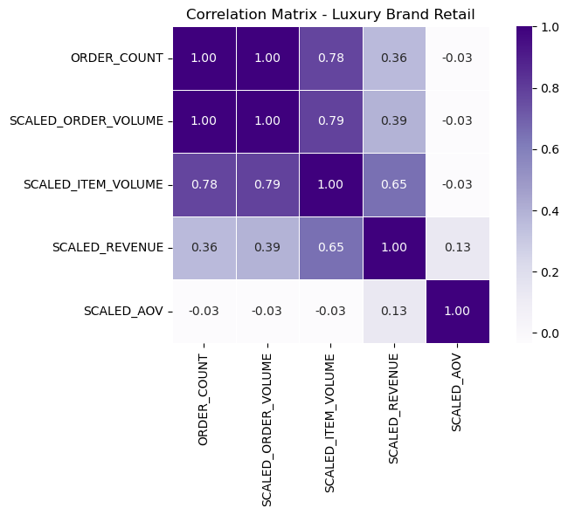
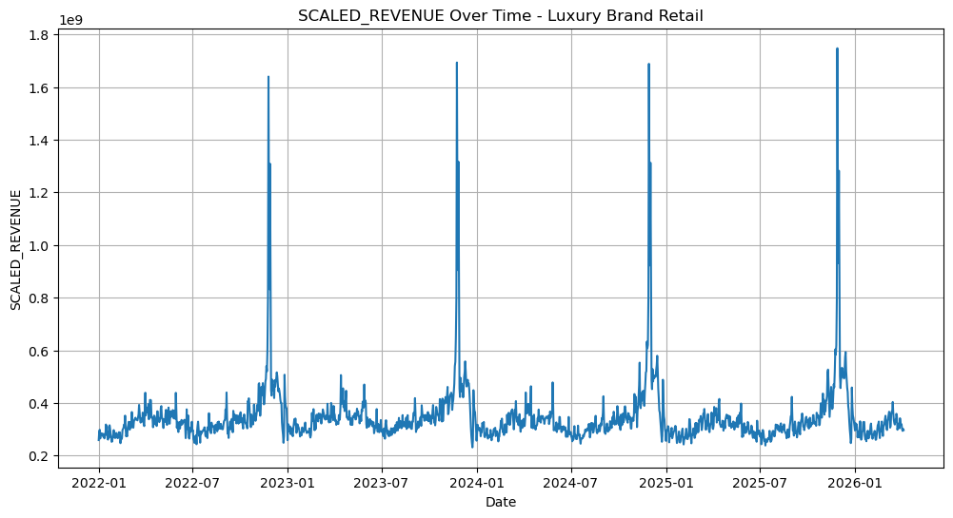
9 / 17
DATA
Exploratory Data Analysis (EDA)
Data Quality
No duplicate records
10% missingness in scaled revenue & AOV
Weak relationship to observed variables
Limited concentration in primary verticals
Distribution Analysis
Revenue, order count & order volume are right-skewed
Many outliers observed across verticals
Correlation Structure
Order count, order volume & item volume correlate strongly with revenue
AOV behaves more independently across verticals
Business Verticals
14 business verticals in total
Narrowed to Luxury Brand Retail, Luxury Dept. Retail, Travel & Finance
Trend & Seasonality
Seasonal patterns in revenue transaction metrics
Holiday demand peaks every December
Notes:
Kevin

Slide 11
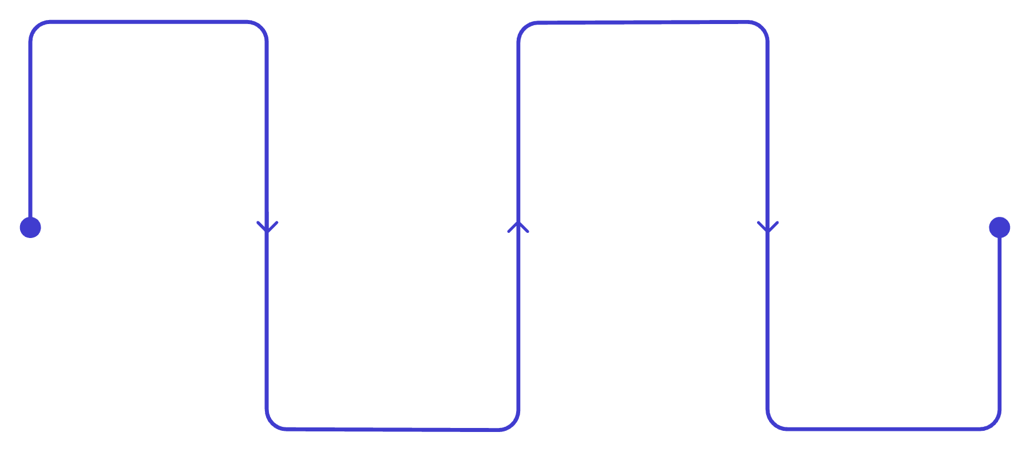
10 / 17
DATA
Preprocessing & Validation Strategy
Missing Values
Normalization
Feature Engineering
Missing values were consistent with MAR behavior and removed due to limited impact on the primary verticals of interest
Standard scaling was applied to normalize the heavily right-skewed feature distributions
Rolling statistics (7-day and 28-day moving averages and standard deviations)
Lag features for revenue, order count, and AOV (1, 7, and 28 days)
Day-over-day and week-over-week percentage change features
Ratio features including items per order and revenue per item
Cyclical sine/cosine encodings for day of week and month
Weekend indicator variables and expanding revenue averages
Vertical and Test/Train Split
Feature Engineering
The dataset was segmented by business vertical and split chronologically into training and testing periods. The length of the testing window can be adjusted by the client
Added features
Notes:
Kevin

Slide 12
11 / 17
MODELING ANALYSIS
Modeling Analysis – Baseline Models
Statistical Forecasting Models
SARIMA/SARIMAX
(Seasonal AutoRegressive Integrated Moving Average/eXogenous regressors)
Autoregressive trend + seasonality modeling; SARIMAX adds external regressors
VAR (Vector AutoRegression)
Multivariate modeling of interdependent time series
GARCH (Generalized AutoRegressive Conditional Heteroskedasticity)
Time-varying volatility (heteroskedasticity) modeling
ETS (Exponential Smoothing)
Level, trend, and seasonal decomposition via smoothing
Machine Learning Models
LightGBM
Histogram-based tree boosting, optimized for speed and scale
XGBoost
Gradient boosting with engineered lag/rolling features
Notes:
Harleen

Slide 13
12 / 17
MODELING ANALYSIS
Modeling Analysis
Foundation Models
TimesFM
Decoder-only pretrained transformer (Google) for zero-shot forecasting
Chronos
Tokenizes time series values, trained as a language model (Amazon, T5-based)
MOMENT
Masked pretraining transformer for forecasting, classification, anomaly detection, imputation
Tiny Time Mixers
Lightweight MLP-Mixer model (IBM), no attention, fast zero/few-shot forecasting
Moirai
Masked encoder transformer (Salesforce) handling arbitrary frequencies/dimensions via any-variate attention
Parameter Efficient Fine-Tuning
P-tuning / Prompt Tuning / Prefix Tuning
Learn continuous prompt vectors prepended to inputs (or to keys/values per layer for prefix tuning); backbone frozen
BitFit
Fine-tunes only bias terms, freezes all other weights
LoRA/QLoRA/DoRA
Trainable low-rank matrices injected into frozen weights; QLoRA adds 4-bit quantization; applies LoRA only to direction
Notes:
Harleen

Slide 14
13 / 17
MODELING ANALYSIS
Modeling Analysis
Metrics
Nine accuracy metrics were computed for every model run; WAPE and MdAPE were tracked as the primary metrics.
WAPE
Weighted Absolute Percentage Error
Primary metric — aggregate, scale-independent accuracy across verticals
MdAPE
Median Absolute Percentage Error
Primary metric — robust to outliers and near-zero revenue days
ALSO TRACKED
MAE
Mean Absolute Error
RMSE
Root Mean Squared Error
MAPE
Mean Absolute Percentage Error
SMAPE
Symmetric MAPE
R²
Coefficient of Determination
Bias
Mean Forecast Error
Pooled Error
Weighted error across candidate models
Notes:
Harleen

Slide 15
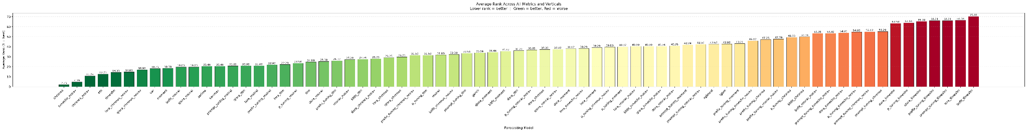
14 / 17
RESULTS
Foundational Models Win
42%
More accurate than the best traditional baseline (WAPE)
3 / 3
Verticals where zero-shot, with covariates Chronos ranked #1
20–25%
Original improvement target — exceeded
Notes:
Aren

Slide 16
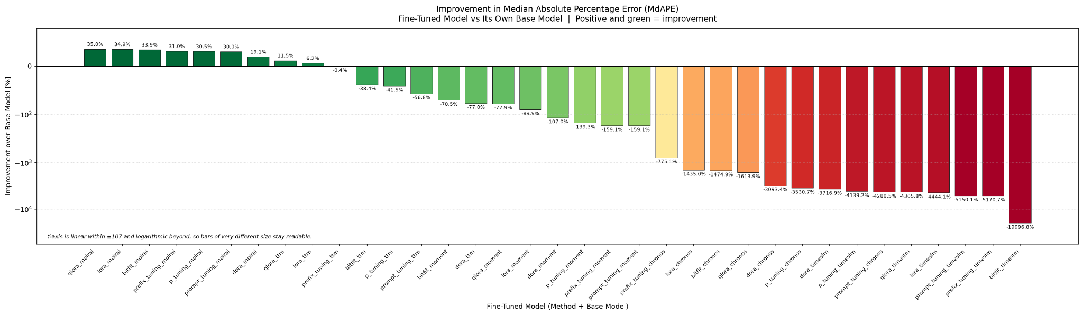
15 / 17
RESULTS
Fine-tuning Didn’t Pay
83%
Of 168 fine-tuned runs got worse than their base model
0
Fine-tunes that beat zero-shot, with covariates Chronos
$0
Training compute needed for the winning model
Notes:
Aren

Slide 17

16 / 17
FINAL TAKEAWAY
Dashboard
Notes:
Harleen

Slide 18
17 / 17
FINAL TAKEAWAY
Final Recommendation and Next Steps
Zero-shot covariate-aware Chronos won every vertical, cutting WAPE by 42% vs the strongest baseline
Replace client-by-client forecasting with standardized vertical forecasting using zero-shot Chronos as the default model, while continuously benchmarking new models as additional data becomes available
Extend to Finance
Process unused Travel Data
Production harden the Dashboard
Scaffolded in the pipeline but never populated
Add it once usable NIQ Finance data is available
Received but blocked by format mismatch
Ingesting it also tests whether more data changes the fine tuning result
Lock down the dashboard so only Rakuten’s internal network can access it
Notes:
Kevin

Slide 19
Appendix
Supporting detail for the dataset, variable definitions, and the full model evaluation results
Appendix A
Data Types & Variable Definitions
Appendix
B
Model Evaluation Charts

Slide 20
Appendix A: Data Types
Feature | Type
ORDER_DATE | object
VERTICAL | object
MERCHANT_NAME | int64
ORDER_COUNT | int64
SCALED_ORDER_VOLUME | int64
SCALED_ITEM_VOLUME | int64
SCALED_REVENUE | float64
SCALED_AOV | float64

Slide 21
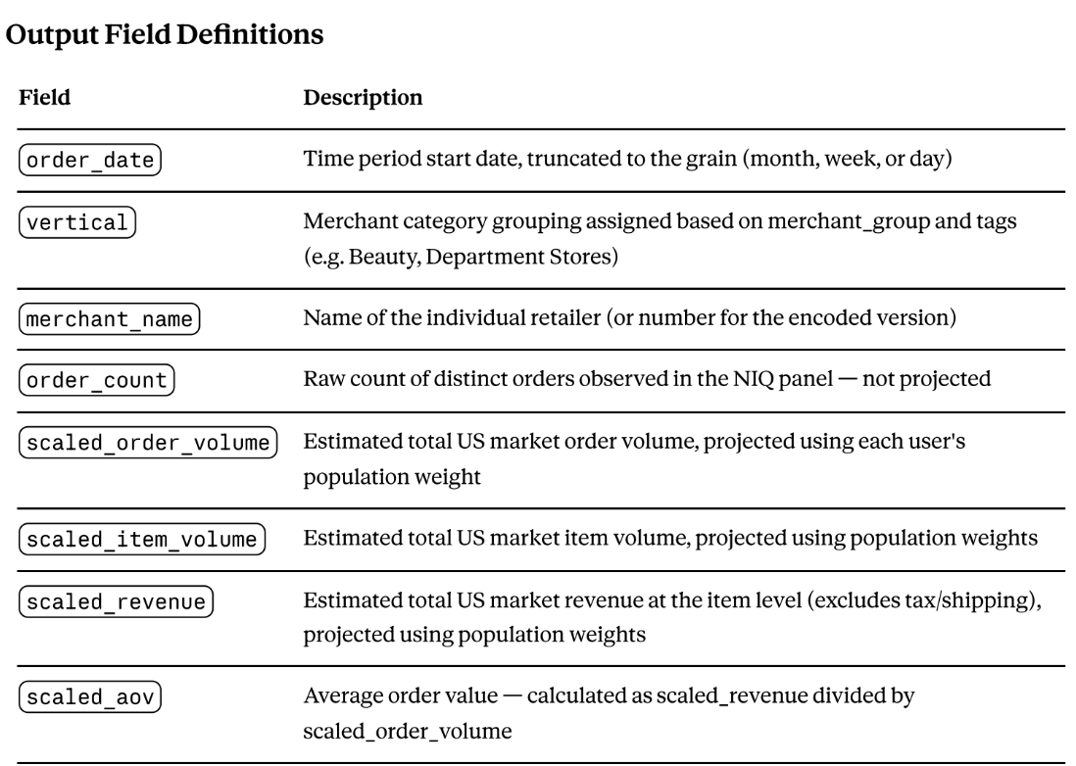
Appendix A: Variable Description

Slide 22
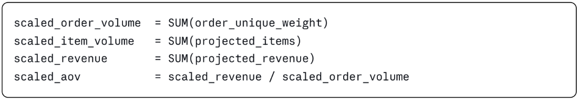
Appendix A: Variable Calculations
1. User Unique Weight
2. Order Unique Weight
3. Scaled Metrics

Slide 23
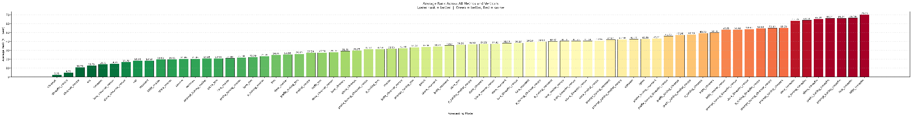
Appendix B: Overall Model Ranking
Average rank of all 71 model configurations per vertical across all eight evaluation metrics and all verticals (1 = best). Covariate-aware Chronos ranks first (2.25); no-covariate TimesFM is second (4.79). Both leaders are zero-shot — no fine-tuned variant places near them.

Slide 24
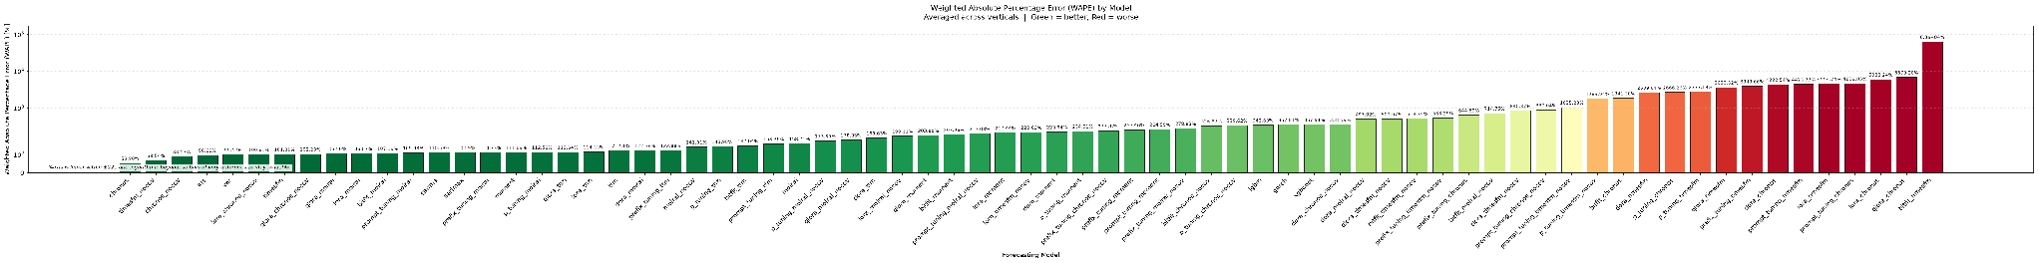
Appendix B: Primary Metric — WAPE by Model
Weighted Absolute Percentage Error (total error over total actual volume), averaged across verticals and sorted best to worst. WAPE is not distorted by near-zero revenue days, and 100% marks the level of a mean-reverting forecast.

Slide 25
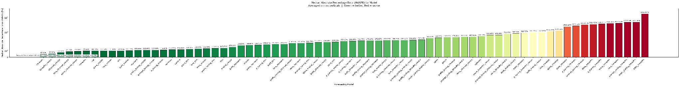
Appendix B: Primary Metric — MdAPE by Model
Median Absolute Percentage Error: the percentage miss on the median day, robust to the extreme days that dominate MAPE. Read as “typical-day accuracy.”

Slide 26
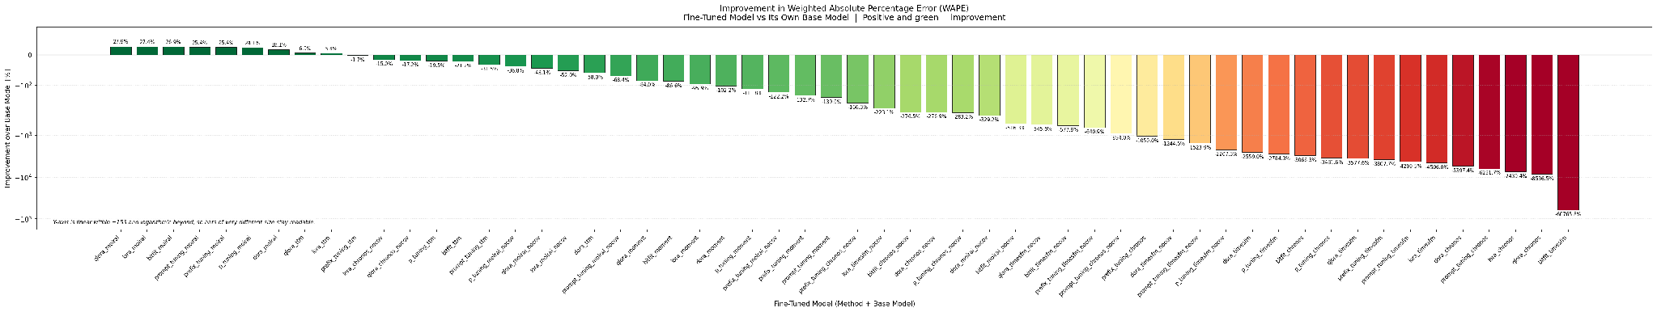
Appendix B: Fine-Tuning Effect on WAPE
Each bar is a fine-tuned variant’s WAPE change relative to its own base model (positive = improvement). Only 17% of the 168 fine-tuned comparisons improved; every method family had a negative median effect.

Slide 27
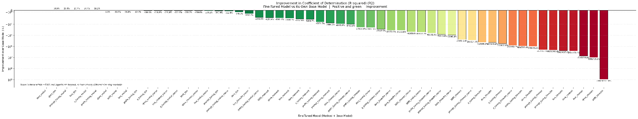
Appendix B: Fine-Tuning Effect on R²
Change in the coefficient of determination relative to each variant’s own base model. Degradation is largest on the strongest backbones; the y-axis is logarithmic beyond the linear region so bars of very different size stay readable.

Slide 28
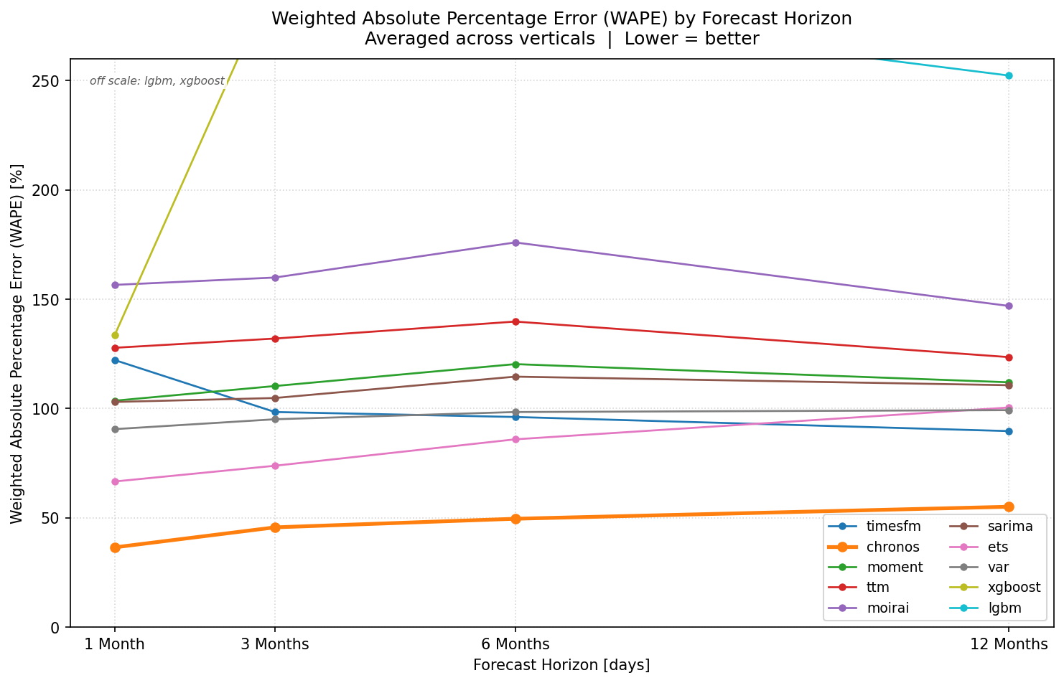
Appendix B: WAPE by Forecast Horizon
Mean WAPE at 30-, 90-, 180-, and 365-day horizons (scored from the first N days of each saved forecast). Covariate-aware Chronos is most accurate at every horizon (36.5% to 55.1%), with no-covariate TimesFM second throughout; lines above the 260% cap are noted on the chart.

Slide 29
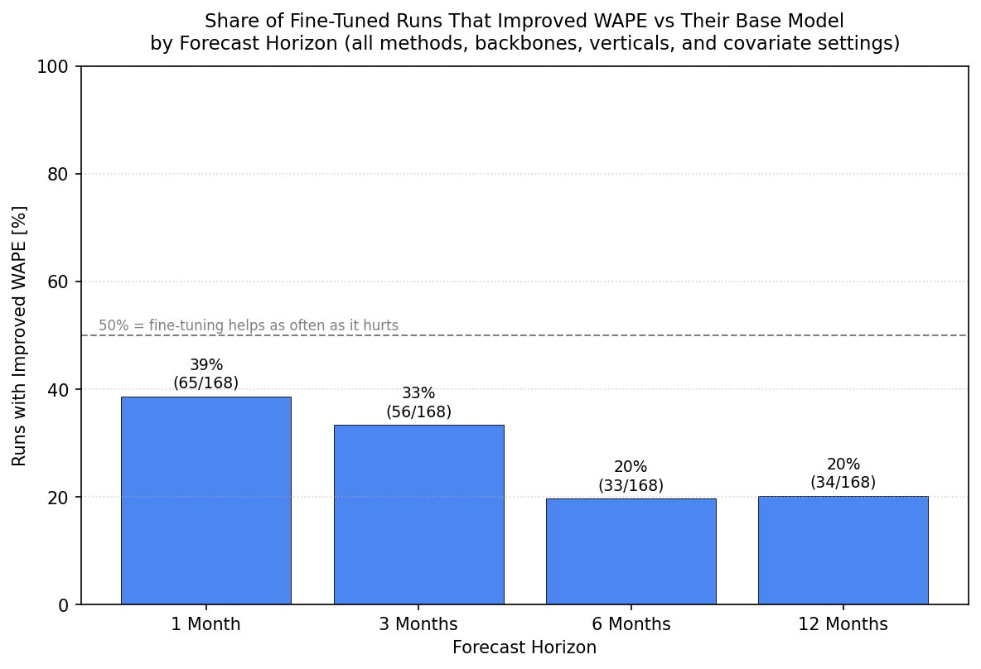
Appendix B: Fine-Tuning Success by Horizon
Share of fine-tuned runs that beat their own base model on WAPE, by horizon. Success falls from 39% at one month to 20% at twelve, and never reaches the 50% break-even line — fine-tuning never helps more often than it hurts.

